Slide 1
Data Analysis on MovieLens --Dennis Silva --Xuanyu Li --Branden Diniz --Chuxin Wei

Slide 2
Findings
Summary Statistics: Ratings
Histograms:Distribution of Ratings
Scatter Plots: Correlation between Men and Women
Business Intelligence: Business Questions

Slide 3
1.Summary Statistics on Ratings
Ratings> 4.5 Stars | Count
All Users | 21
Men | 23
Women | 51
Ratings>4.5 Stars Age>30 | Count
Men | 86
Women | 149

Slide 4
1.Summary Statistics on Ratings
Top Ten Most Popular Movies
Movie ID | Movie Title | Number of Ratings
3858 | American Beauty (1999) | 3428
260 | Star Wars: Episode IV – A New Hope (1977) | 2991
1196 | Star Wars: Episode V – The Empire Strikes Back (1980) | 2990
1210 | Star Wars: Episode VI – Return of the Jedi (1983) | 2883
480 | Jurassic Park (1993) | 2672
2028 | Saving Private Ryan (1998) | 2653
589 | Terminator 2: Judgment Day (1991) | 2649
2571 | The Matrix (1999) | 2590
1270 | Back to the Future (1985) | 2583
593 | The Silence of the Lambs (1991) | 2578

Slide 5
1.Summary Statistics on Ratings
Question: Which age group is easiest to please?
Conjecture: the extrema of these groups (<18 and >56) were the most easiest to please.
Conclusion:The conjecture was wrong and the 35-44 age group was the most easy to please.
Age Group | <18 | 18-24 | 25-34 | 35-44 | 45-49 | 50-56 | >56
Rating Variance | 0.7920 | 0.6275 | 0.5139 | 0.4877 | 0.5123 | 0.6219 | 0.6725

Slide 6
1.Summary Statistics on Ratings
Correlation Between the Average Ratings of Movies Between Different Age Groups
Age Group | <18 | 18-24 | 25-34 | 35-44 | 45-49 | 50-56 | >56 | Average Correlation
<18 | 1.000 | 0.5328 | 0.5654 | 0.5074 | 0.4936 | 0.4631 | 0.4089 | 0.5673
18-24 | 0.5328 | 1.000 | 0.6914 | 0.6027 | 0.5667 | 0.5364 | 0.4513 | 0.6259
25-34 | 0.5654 | 0.6914 | 1.000 | 0.7633 | 0.6886 | 0.6789 | 0.5845 | 0.7103
35-44 | 0.5074 | 0.6027 | 0.7633 | 1.000 | 0.6878 | 0.6903 | 0.6188 | 0.6957
45-49 | 0.4936 | 0.5667 | 0.6886 | 0.6878 | 1.000 | 0.6633 | 0.5926 | 0.6704
50-56 | 0.4631 | 0.5364 | 0.6789 | 0.6903 | 0.6633 | 1.000 | 0.6123 | 0.6635
>56 | 0.4089 | 0.4513 | 0.5845 | 0.6188 | 0.5926 | 0.6123 | 1.000 | 0.6098
Average Correlation | 0.5673 | 0.6259 | 0.7103 | 0.6957 | 0.6704 | 0.6635 | 0.6098

Slide 7
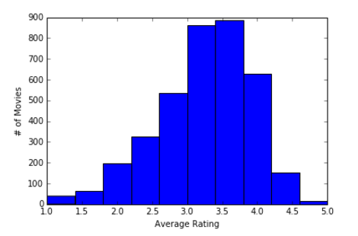
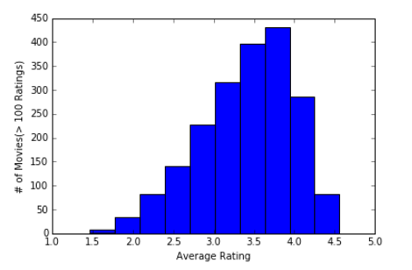
2. Histograms:Distribution of Ratings
1. The majority of users tend to rate movies between 3 and 4 stars.
2. The tails disappear when we only use movies rated more than 100 times. 3. Kurtosis analysis:
The original histogram has a kurtosis of 0.3246, the kurtosis becomes -0.2478 in the second histogram.
Tails change from “fat” to “thin”

Slide 8
2.Histograms-the number of average ratings over each age group
Conjecture: the 25-34 and the 35-44 age group’s average rating patterns can be used to extrapolate the rating patterns of the entire population of users.

Slide 9
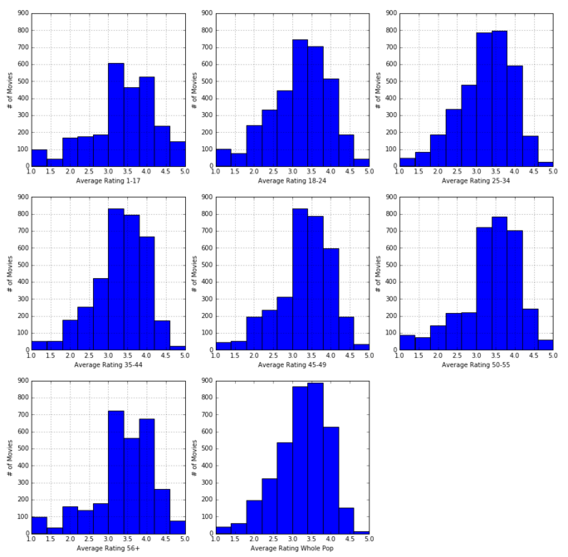
2.Histograms-the number of average ratings over each age group

Slide 10
2.Histograms
One-way Chi-squared Test
Conclusion: These two age group’s average rating distribution are consistent with the overall population’s rating distribution.
Note： 25-34 year olds make up ~18% of total population
35-44 year olds make up ~40% of total population
Age | Test Statistics | P-Value | Hypothesis
25-34 | 1.062 | 0.9993 | Accept
35-44 | 1.661 | 0.9958 | Accept
>56 | 34.72 | 6.677e-05 | Reject

Slide 11
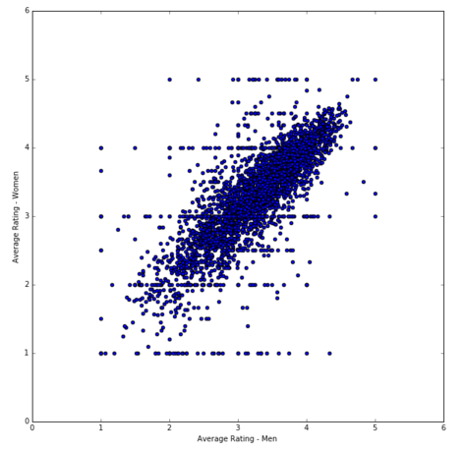
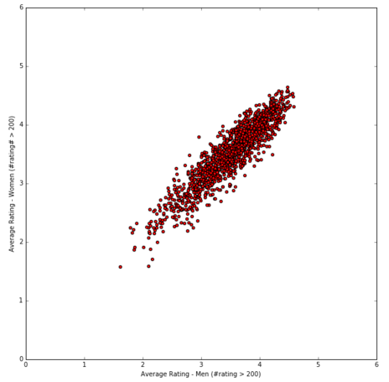
3. Scatter Plots—Correlation between Men and Women
Average Rating(F)
Average Rating(F)
Average Rating(M)
Average Rating(M)
Correlation Coefficient: 0.7632
(moderate )
Correlation Coefficient: 0.9184
(High)

Slide 12
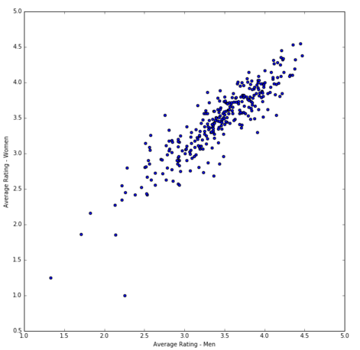
3. Scatter Plots—Correlation between Men and Women
Conjecture: Men and women must also rate similarly under other circumstances.
Results:
Correlation Coefficient=0.9015
(High)
Conclusion: Men and women are strongly correlated when rating different types of movie genre rather than solely individual movies.
Ratings from Men and Women by Genre

Slide 13
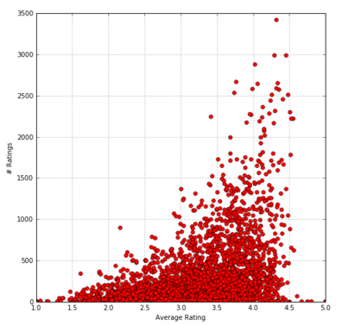
4.Business Intelligence: Business Questions
Business Question: What movies should be kept and what movies should be removed from the system?
Relationship between Average Rating and Number of Ratings
Results:
Data is concentrated less than 500 ratings per movie
Ratings: between 2 and 4
Trend: The more ratings a movie has, the higher likelihood it is rated moderately high
“Popular” movies are also good.

Slide 14
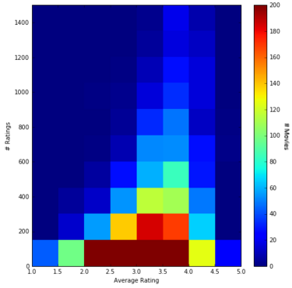
4.Business Intelligence: Business Questions
Average Rating vs. Number of Ratings (With added binned density)
Most movies are rated less than 150 times and receive average ratings .
Movies that have a fair number of ratings (>600) yet have a relatively low score (<2.5) may want to be removed from the system.
Movies that have a fair number of ratings (>600) and a relatively high score (>4.0) may want to be recommended to more users.

Slide 15
Thank You

